Slide 1

Mastering a Metadata -Driven Framework with Fabric SQL Database and Data Factory

Slide 2
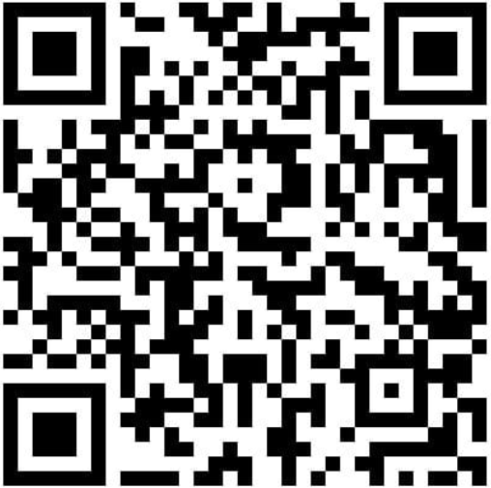





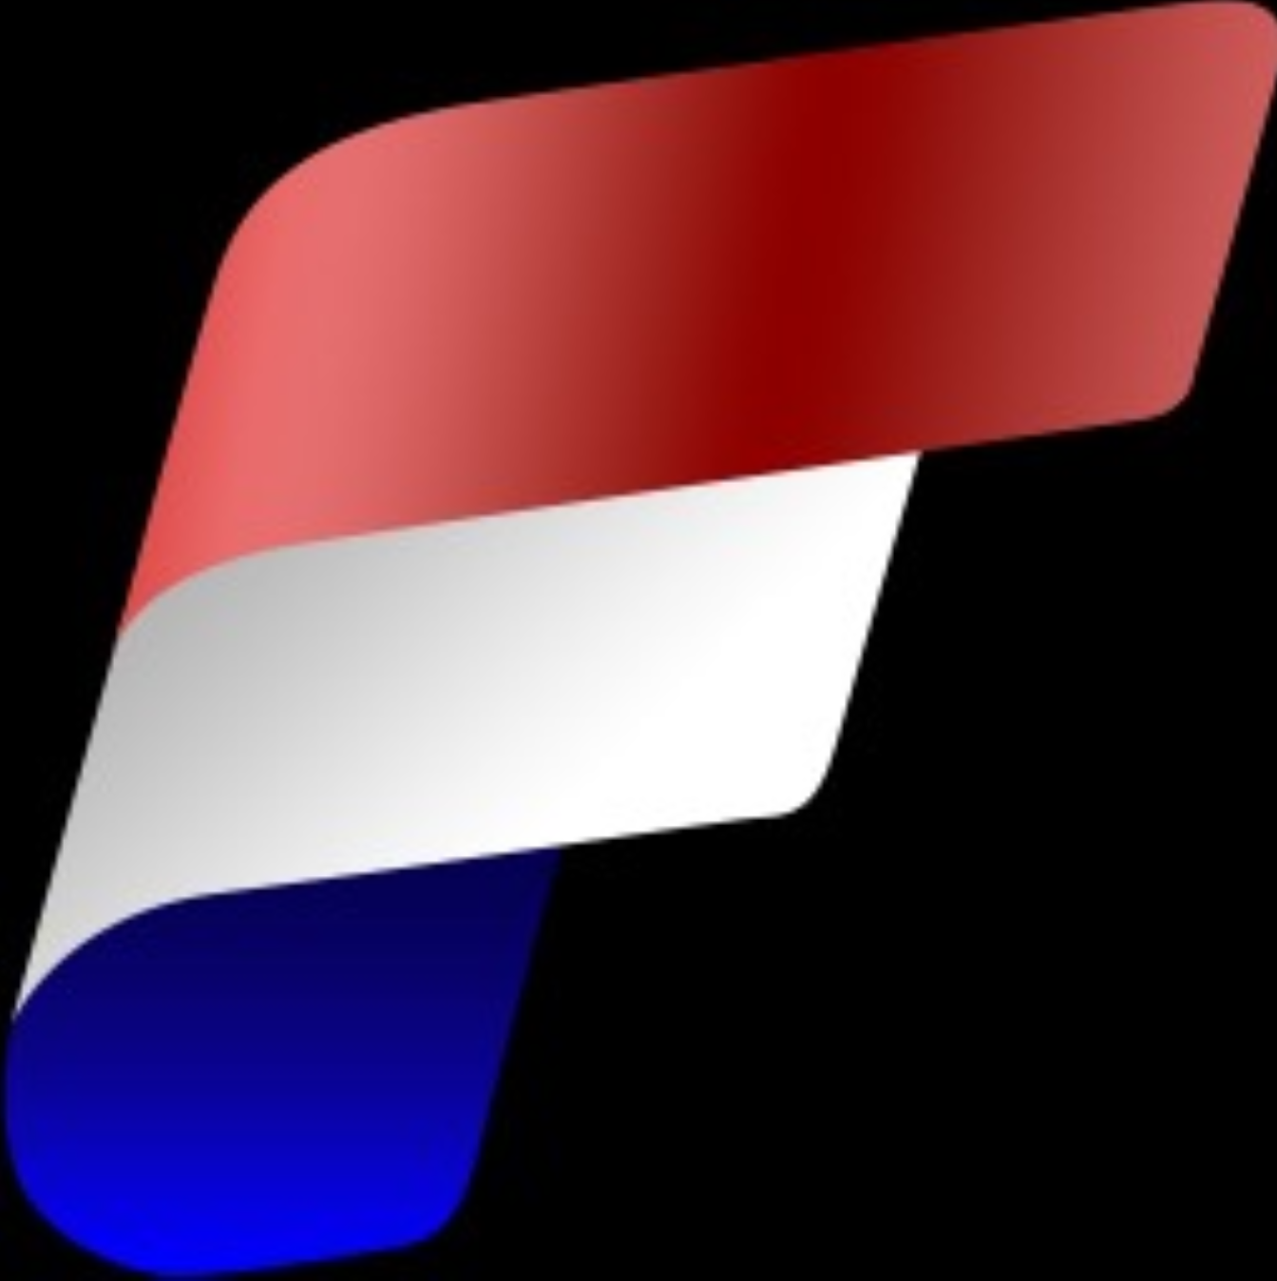


Let’s connect
Principal Consultant
Lead Data & AI InSpark
Erwin de Kreuk
@erwindekreuk.bsky.social linkedin.com/in/erwindekreuk
erwindekreuk.com
github.com/edkreuk
https://sessionize.com/erwin-de-kreuk/
Dutchfabricusergroup.com
Notes:
We help organizations accelerating their digital transformation with impactful Microsoft solutions & expertise

Slide 3

Fabric Metadata Driven Framework
Meets most of your needs
Full control over design and features.
Less development effort.
Flexibility and extensibility.
Lower upfront costs.
100% Fabric Native Solution

Slide 4
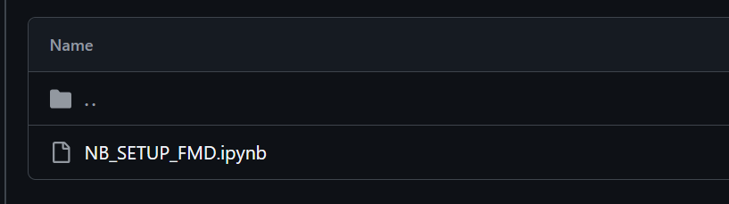
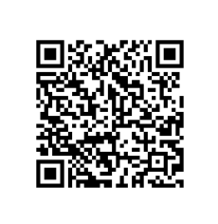
Fabric Metadata Driven Framework
Download Notebook from Github

